Slide 1
Implementation of Kafka: Flight Alert
By Likhitha Javvaji Naveen Reddy Narayana

Slide 2




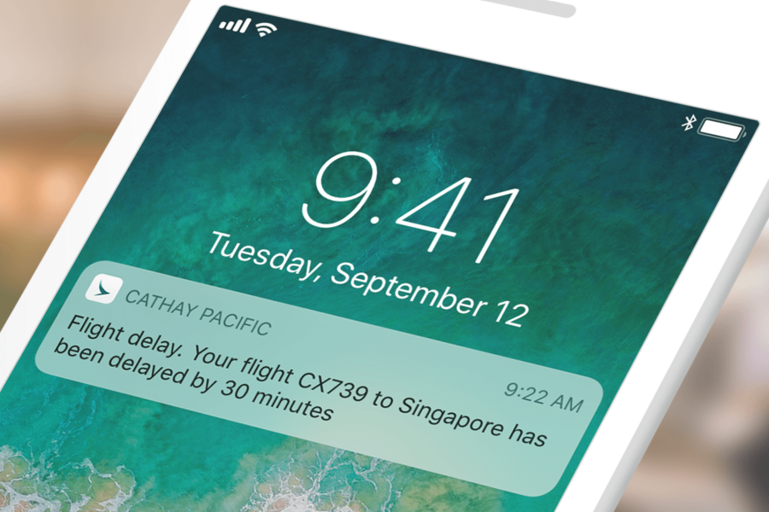
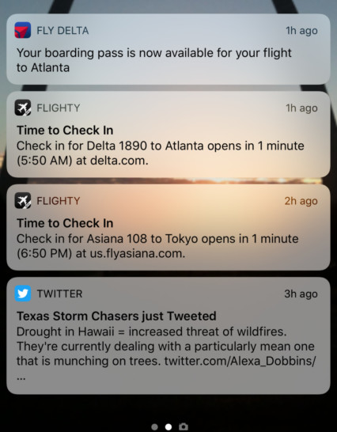

Project Idea:
The idea of the project is to implement an end-to-end use case to Send Alerts About the respective Flight Details by using Kafka as the streaming platform.

Slide 3
Technical challenges:
Below are some of the technical challenges that we faced during our project implementation :
Learnt about Zookeeper and its configuration.
Learnt and enhanced knowledge on Kafka Streaming Platform. Gained a good amount of knowledge on Kafka producer and consumer properties which defines the behavior of the Kafka producer and consumer.
Faced the challenge to form a connection between the database and Kafka producer to send messages for each topic.
Faced the challenge to calculate the time when Kafka producer sends a message to the topic.

Slide 4
Solution Path:
When we choose this project, we came across different technologies like Traditional messaging systems, Databases, File-Based storage.
Kafka appears to be better suitable for issuing alerts in real-time when compared to the above-mentioned technologies because it can handle large amounts of data and is designed to be extremely scalable.

Slide 5
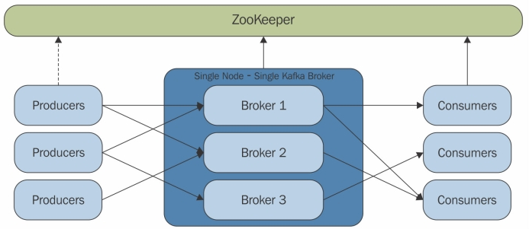
What is Zookeeper?
Zookeeper is a distributed coordination service that is used by Kafka to manage and maintain its cluster state. Zookeeper is a separate system from Kafka, but it is critical for Kafka to function properly.

Slide 6
What is Kafka?
Apache Kafka is a distributed publish-subscribe messaging system and a robust queue that can handle a high volume of data and enables us to pass messages from one end-point to another.
Kafka is suitable for both offline and online message consumption.
Kafka messages are persisted on the disk and replicated within the cluster to prevent data loss.
Kafka is built on top of the ZooKeeper synchronization service.

Slide 7
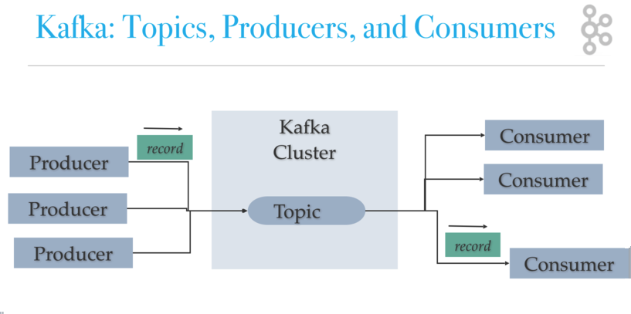
Kafka Producer/Consumer
Producers write to Topic(s) and Consumers read from Topic(s).
Data streams in the Kafka server are sourced from producers.​
Customers read Kafka according to their own pattern.​
A processor is a program that changes the data in a topic's records or entries in a Kafka cluster.​

Slide 8
Approach and Results:
Producer Kafka server Consumer ​
Stored about Flight details like information about respective flights, flight discounts, flight checkin, flight delay.
Created Kafka topics like flight_alert, flight_discount_alert, flight_delay_alert, flight_checkin_alert.
Created a class called FlightKafkaProducer. Here the producer collects the data from database and push the data to the respective kafka topics which can then be consumed by consumers in real time.
In producer class, calculated the time that it would take the time to send the message to the respective kafka topic.
Created a consumer class to subscribe the topic and read messages from one or more partitions within those topics.

Slide 9
Process of Execution:
Initially, we need to start the Zookeeper.
Next we need to start the kafka.
Create the respective topics.
Run the FlightKafkaConsumer class.
Run the FlightKafkaProducer class.
As a result, Producer sends a message to the topic. Now the consumer subscribe the topic and read messages within those topics.
In both the consoles( i.e FlightKafkaConsumer and FlightKafkaProducer) , we can see the messages of each topic and the time taken to process in consumer class. Also, In producer class, we can see the time taken to send the message for each topic.

Slide 10

Zookeeper Initialization

Slide 11

Kafka Server Initialization

Slide 12
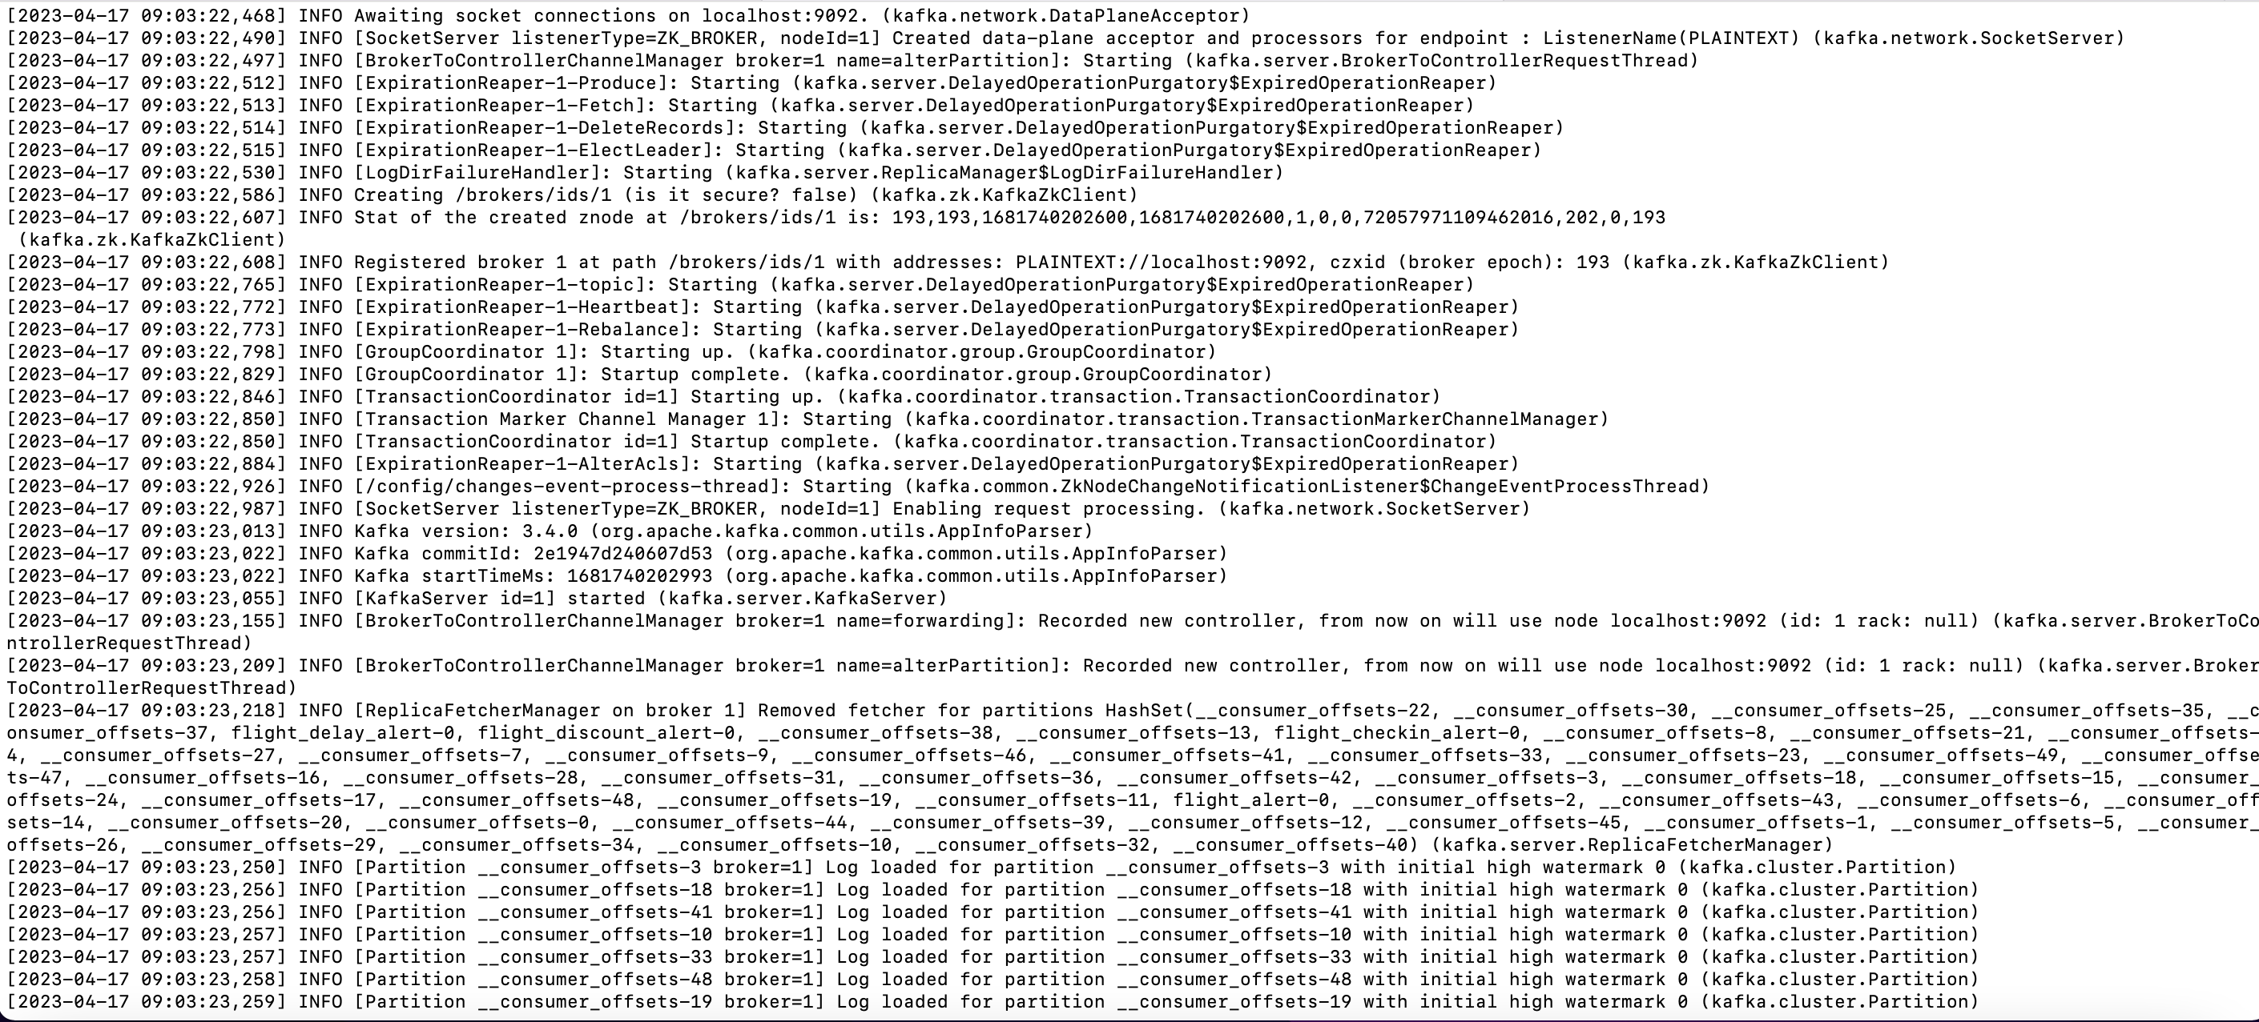
Kafka Server Log

Slide 13
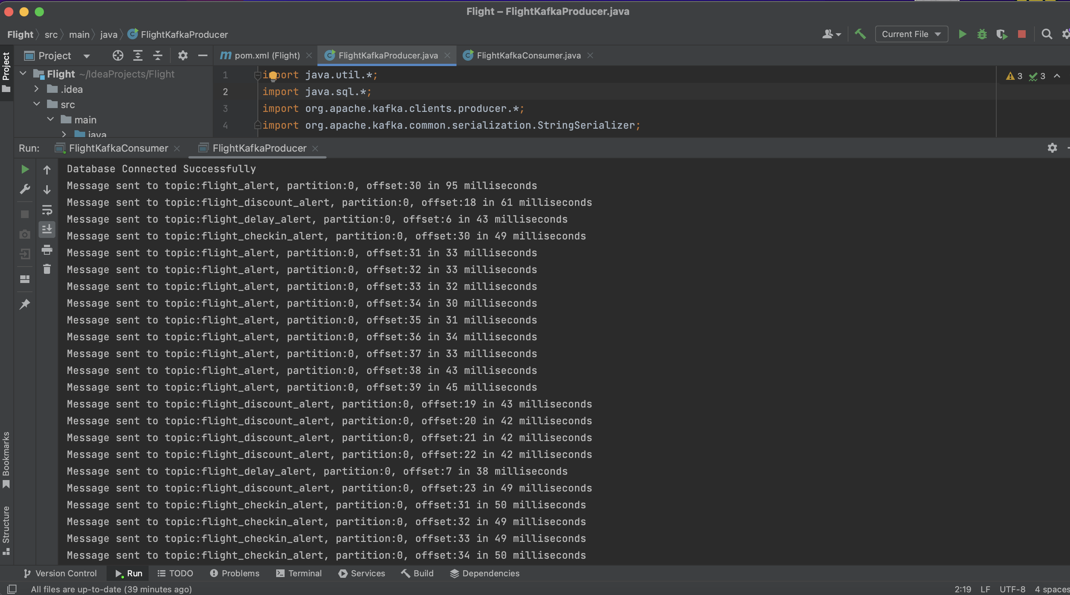
Output in the Kafka Producer console

Slide 14
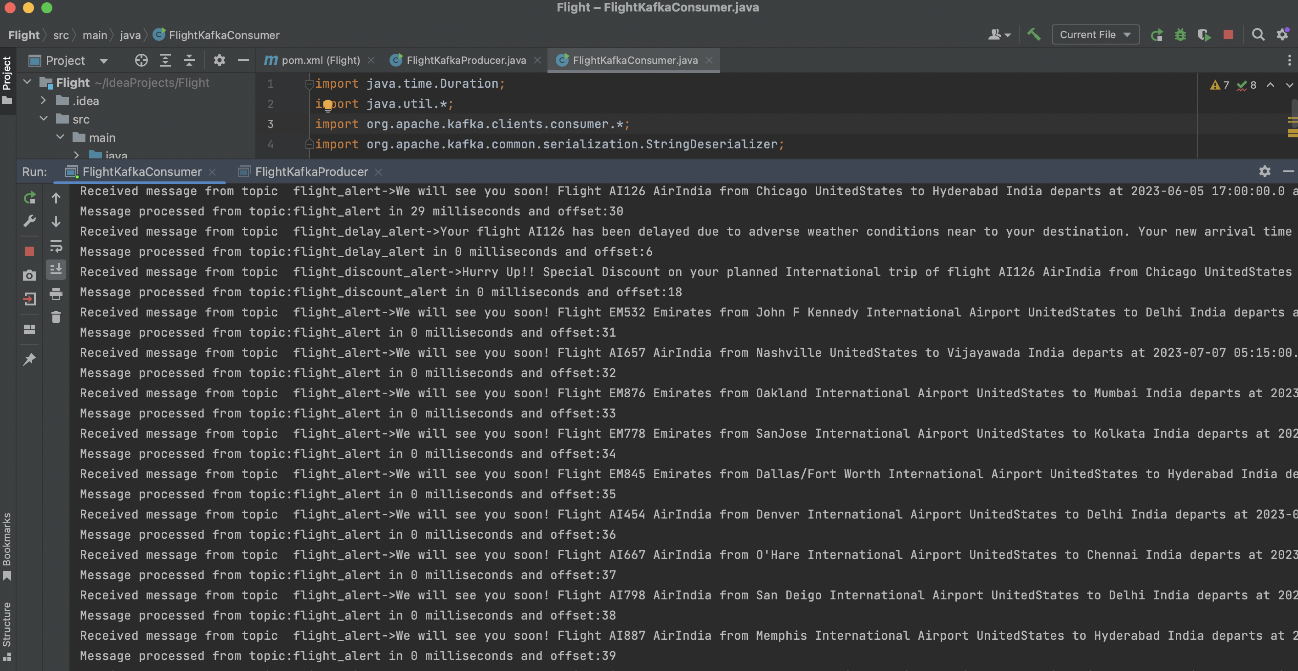
Output in the Kafka Consumer console

Slide 15
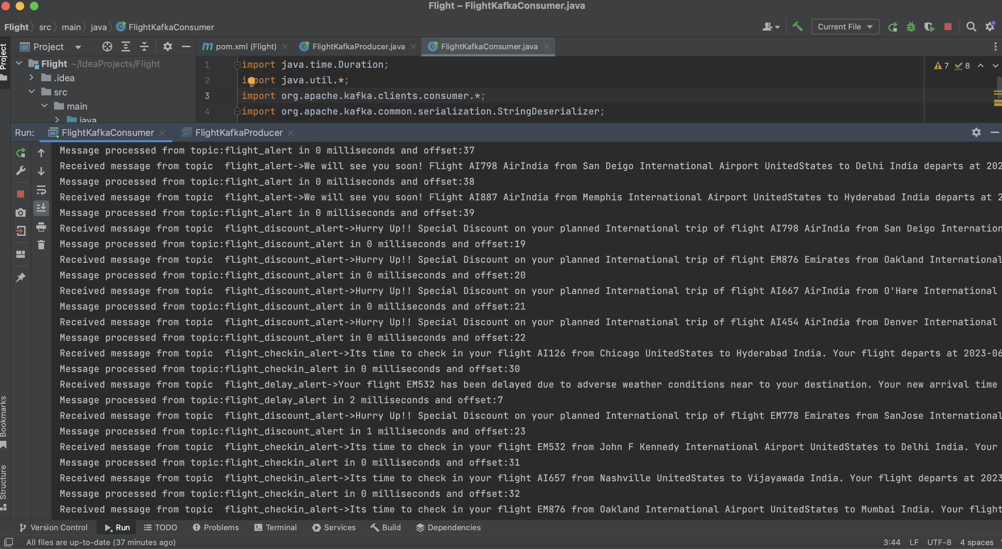
Output in the Kafka Consumer console

Slide 16
Future Work :
Due to the time constraint, we majorly focused on Kafka producer and consumer implementation.
In future, we would like to design the front end for our project.

Slide 17
Conclusion:
In the case of flight alerts, Kafka may be used to interact with numerous data sources (like flight data providers), process the data, and send alerts via a variety of channels (including email, SMS, and mobile apps).
Large amounts of data can be managed while ensuring that notifications are sent quickly and effectively by using Kafka.
In addition, the fault-tolerant architecture of Kafka can help to ensure that alerts are not lost as a result of disruptions or system failures.
Overall, adopting Kafka for flight alerts can assist to increase the precision and timeliness of alerts improving consumer happiness and operational effectiveness for airlines and other airline stakeholders.

Slide 18


